Slide 1



EMIT-VISIONS-ISS COPILOT - CAGLIARI
EMIT FOR THE FUTURE! – HOW TO USE EMIT OPEN SOURCE DATA FOR RAISE AWARENESS ABOUT GLOBAL WARMING.
TEAM:
Nicolò Melis: Recent graduate in engineering
Fabio Pisano: Technology enthusiast
Maurizio Naletto: R&D Engineer
Davide Pisano: Student 2nd year High School
https://www.emit-vision-iss-copilot.com/
https://github.com/MaurizioNaletto-code/EMIT-VISIONS-ISS-COPILOT
Mail: isscopilot@gmail.com

Slide 2
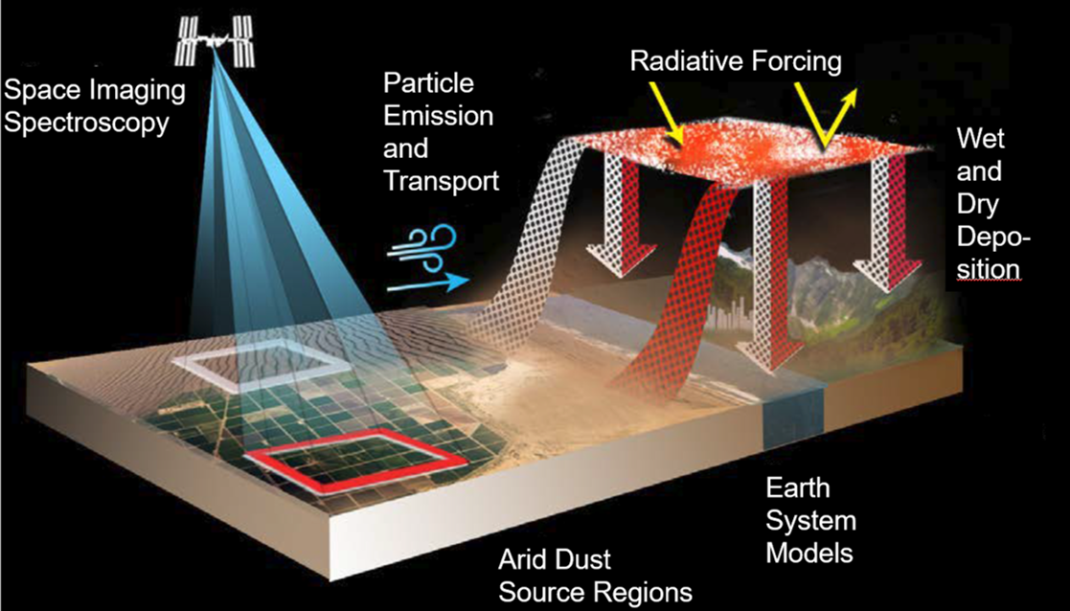
EMIT-VISIONS-ISS COPILOT
Emit is a modern technology for the study of our planet, it provides us with data to understand climate change and more generally to understand our planet. We followed the NASA tutorials for Emit on and thought about what we had in front of us.
EMIT FOR THE FUTURE
The future is where the new generations are. So we thought about how to create a simple way to use these technologies, creating paths to see closely how we work with space technologies, in a special way, using the open-source tools provided by NASA.
The «ISS SPACE CAMERA»
The EMIT instrument is an imaging spectrometer that will measure light in visible and infrared wavelengths. They display unique spectral signatures indicating the mineral composition of the surface.
- HOW TO MAKE NEW GENERATIONS USE THIS DATA?
MAKING THEM BECOME SPACE INVESTIGATORS
-WHAT ABOUT HIGH SCHOOL STUDENTS AND RESEARCHERS?
GIVING THEM A NOTEBOOK AND A GUIDE+VIDEO TO EXTRACTING DATA SIMPLIFYING THE NASA GUIDE, ADDING A SMALL ALGORITHM TO OBTAIN THE NUMERICAL DATA EASILY
CAGLIARI

Slide 3
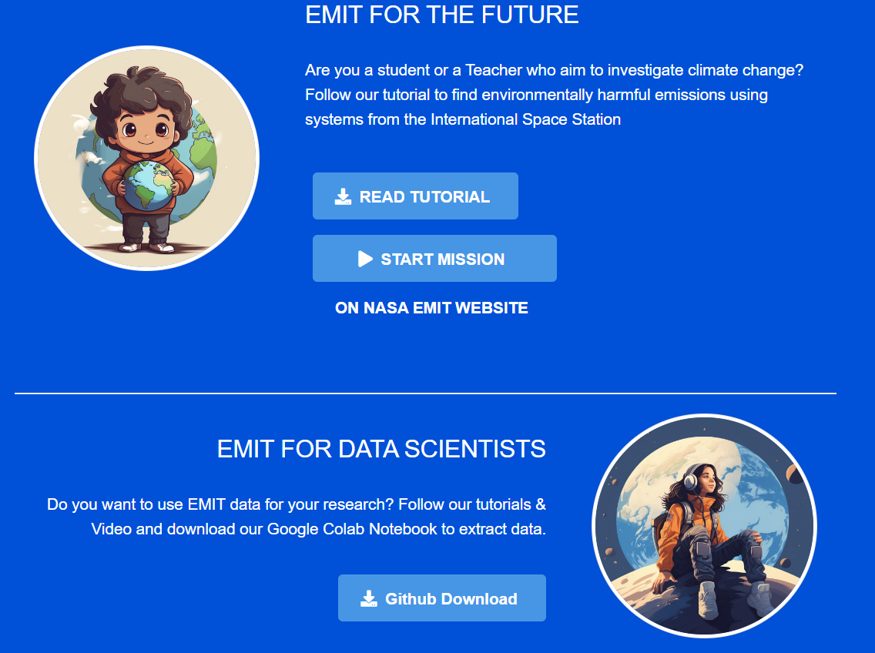
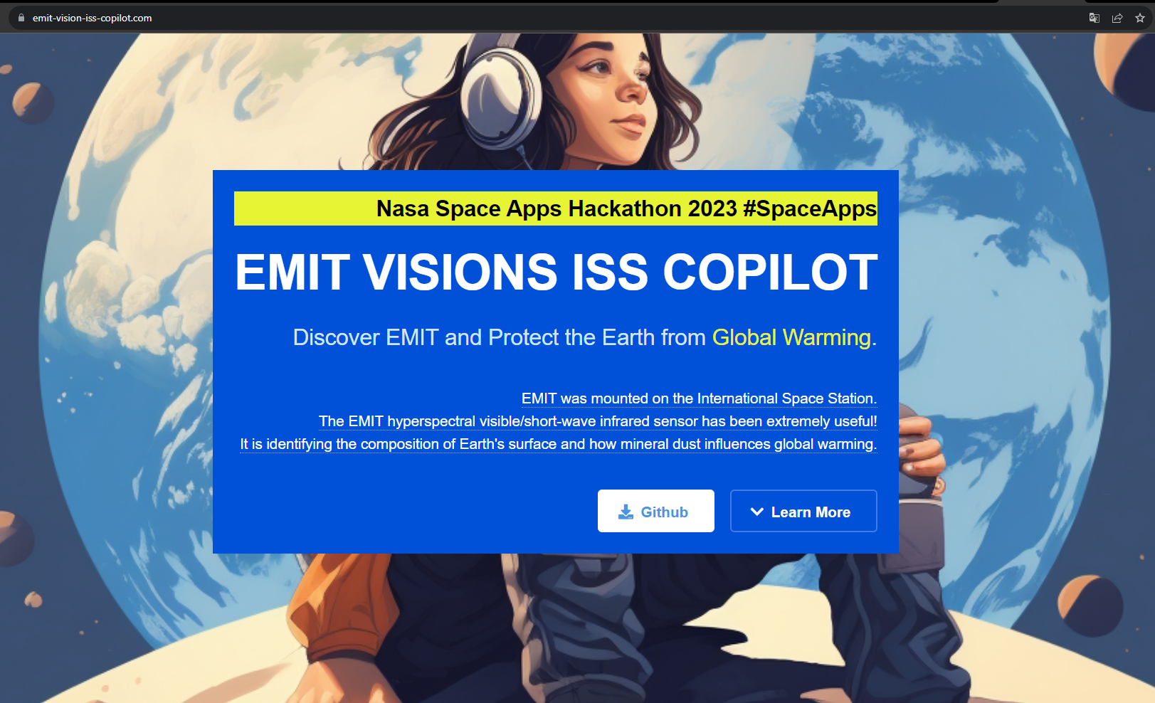
EMIT-VISIONS-ISS COPILOT
We built a website for this mission…
Our site is the co-pilot that contains direct links to the tutorials and the github repository link.
CAGLIARI

Slide 4
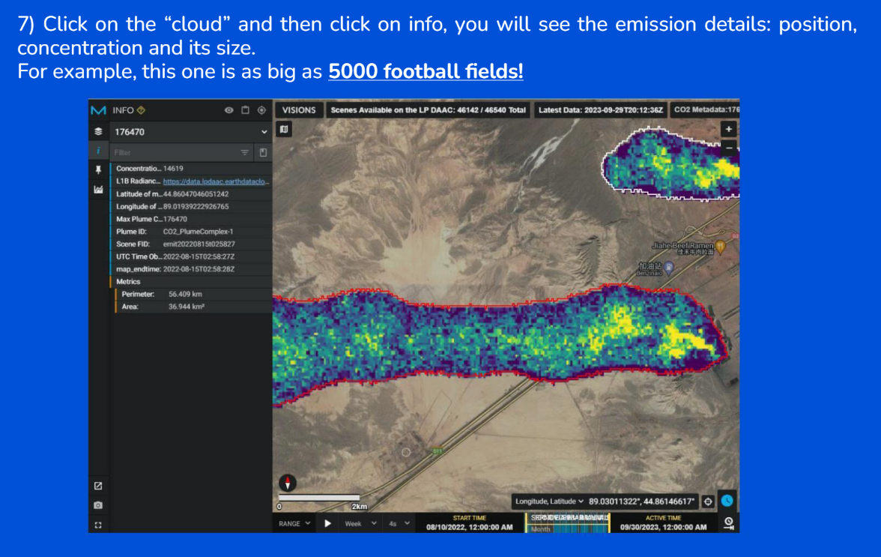
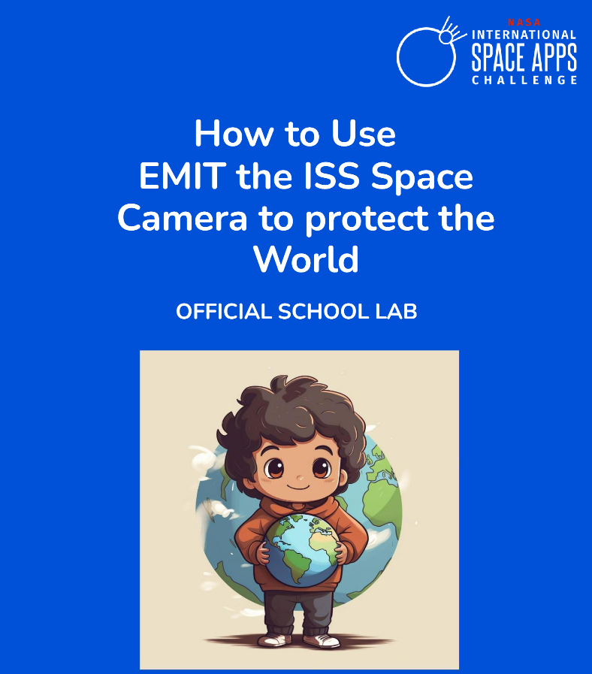
EMIT-VISIONS-ISS COPILOT
How does it work for middle and elementary school students?
Through a guided tutorial in PDF and a link, they are guided to find greenhouse gases and their location. Even in their region, if there is EMIT system acquisition on the space station.
CAGLIARI

Slide 5
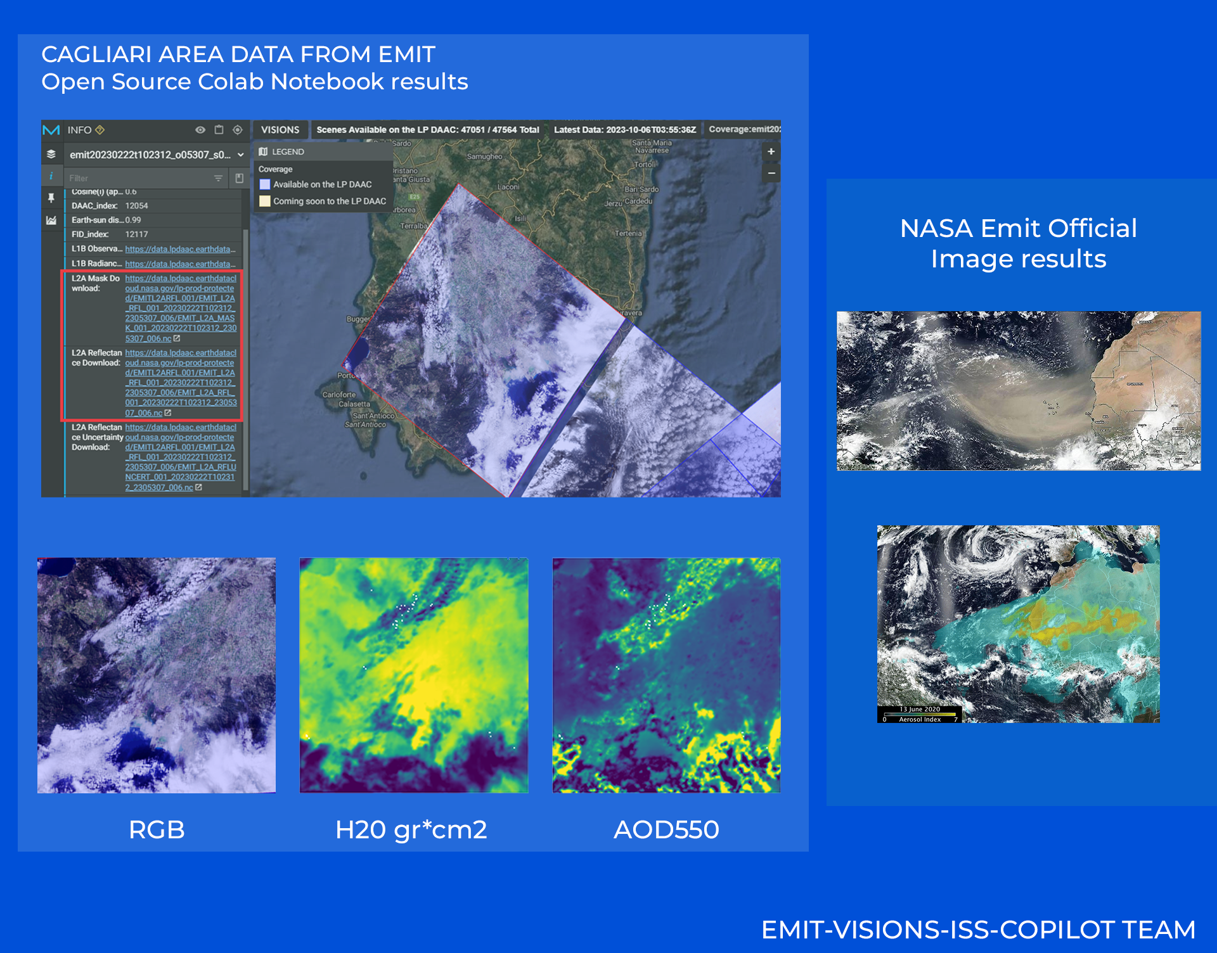
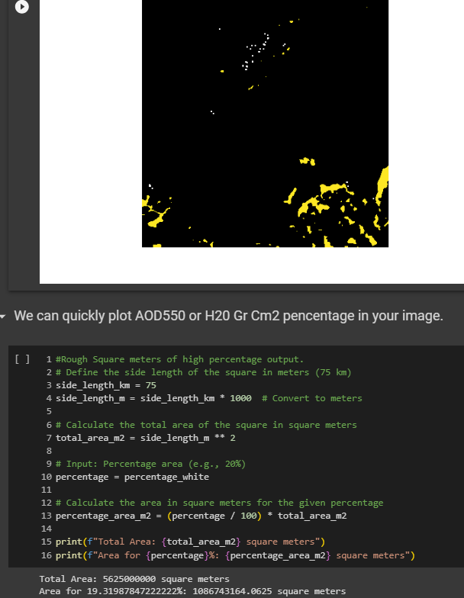
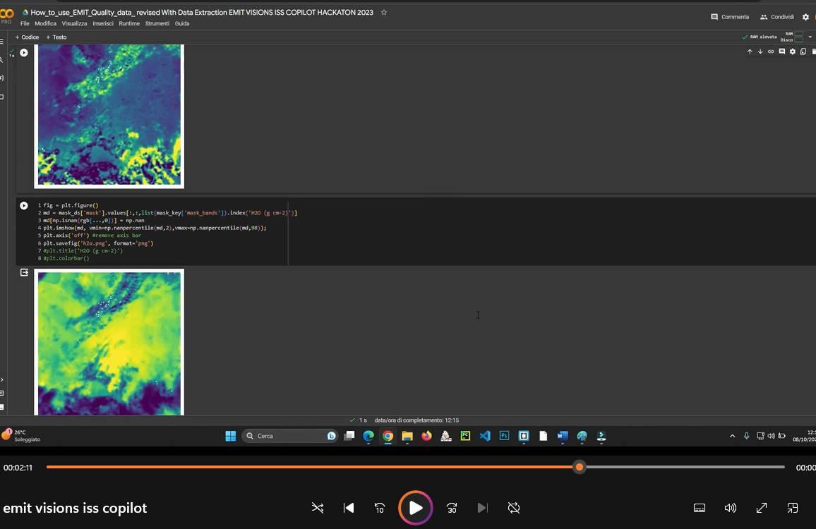
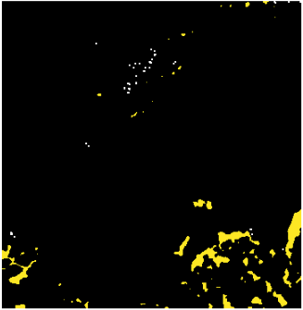
EMIT-VISIONS-ISS COPILOT
How does it work for high school students or researchers?
Through a guided tutorial in PDF a video and a google notebook, who contain Open CV AI machine vision algorithm to extract data.
CAGLIARI

Slide 6
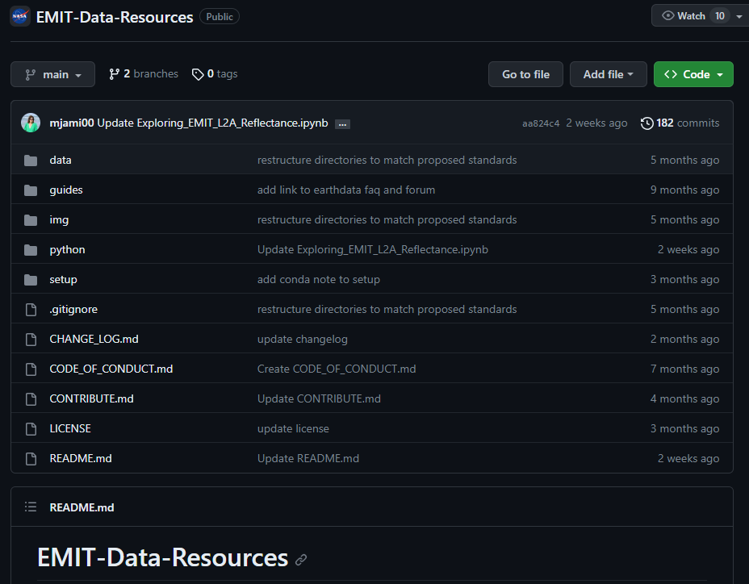
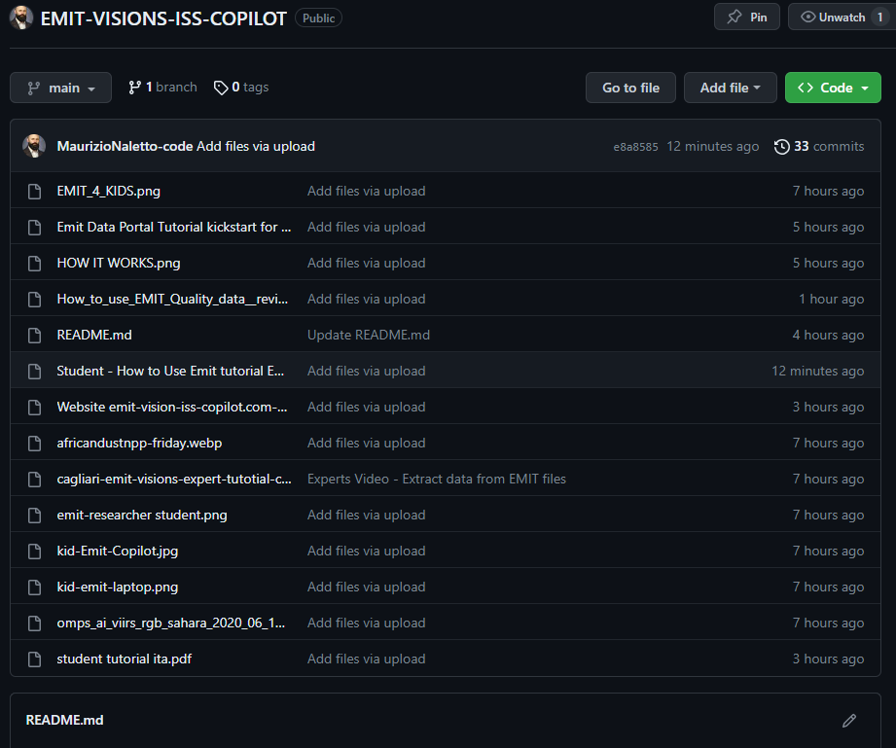
EMIT-VISIONS-ISS COPILOT
Our system is an adaptation of official NASA systems, you can download it from github and modify it for your own uses. It includes all the tutorials, videos, images & also our website.
CAGLIARI

Slide 7
EMIT-VISIONS-ISS COPILOT
Thank you!
UnOfficial website https://www.emit-vision-iss-copilot.com/
https://github.com/MaurizioNaletto-code/EMIT-VISIONS-ISS-COPILOT
Mail: isscopilot@gmail.com
CAGLIARI

